Slide 1
CPI 310 Blog
By Sunny Danger Liu

Slide 2
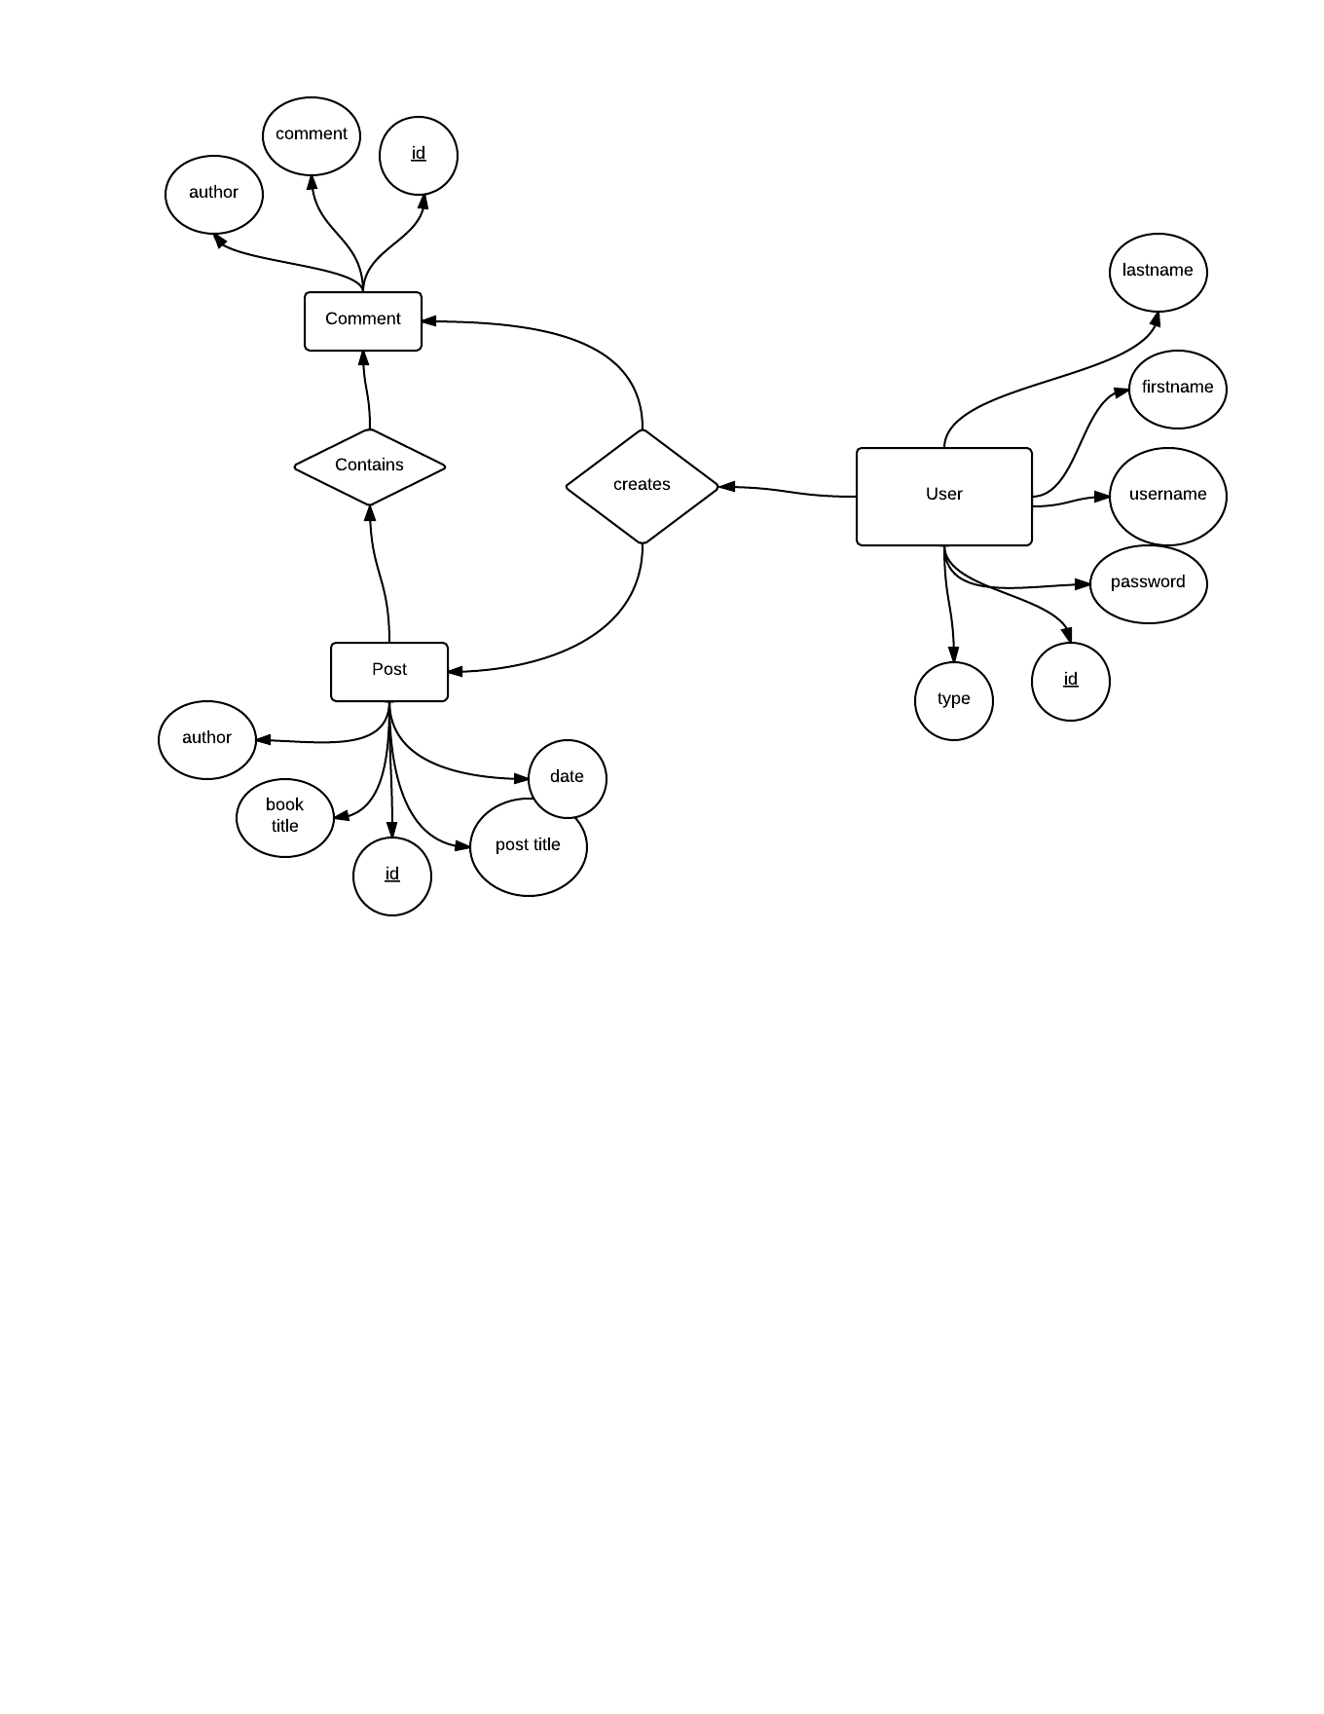
E-R Diagram

Slide 3
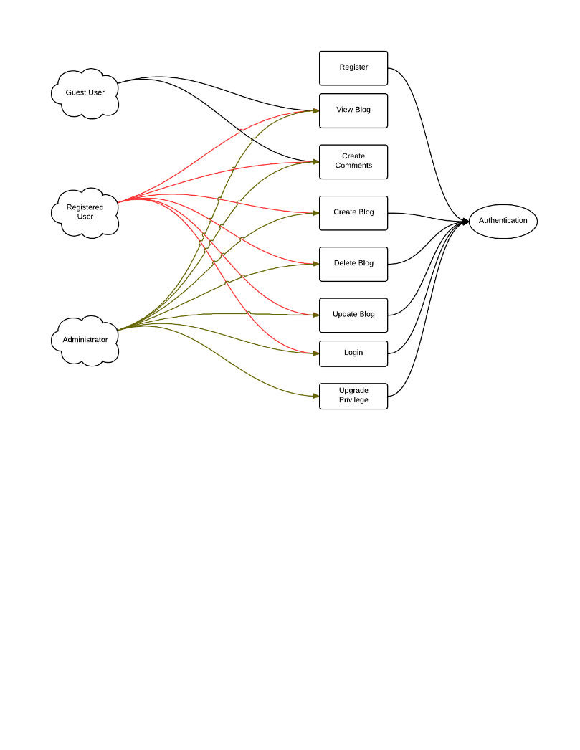
User Case Diagram

Slide 4
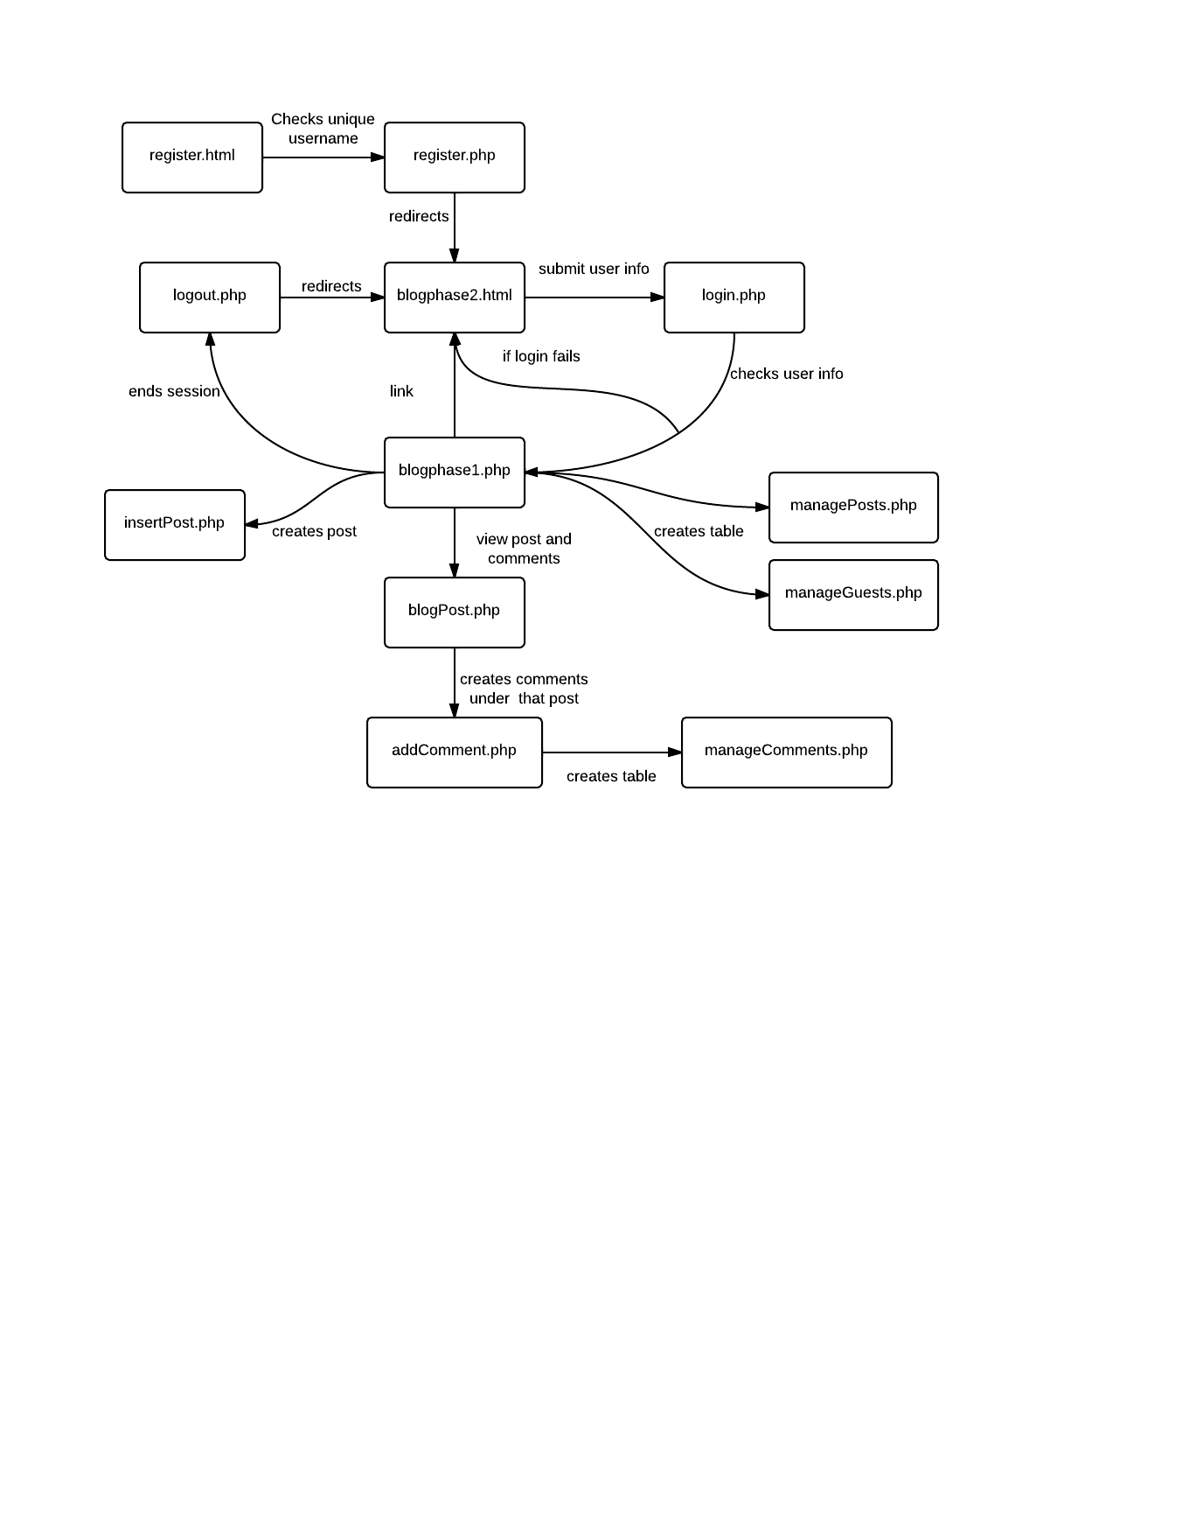
Software Architecture

Slide 5
Application Details
Admin page
Cat
Need better presentation
Not enough security

